Slide 1
ORGANIZATION OF HEALTHCARE SERVICES
DOREEN KAPTERIT
2023

Slide 2
Objectives
By the end of this module, The student should be able to:
1. Explain the concepts of health systems and health systems management.
2. Identify and discuss the structure, roles and responsibilities of the Kenya health system.

Slide 3
Terminology definitions.
Health System Management (HSM) – WHO.
Is the coordination of provision of preventive, curative, promotional or rehabilitative health care services through effective management of facilities, HRH, financial and other resources.
Health Services Manager is someone who spends a substantial proportion of his/her time managing.
Resources such as staff, budgets, drugs, equipment, buildings and information, including planning, implementation and evaluation; staff, budgets, drugs, equipment, buildings and information service users, and partners.

Slide 4
Health Systems includes.
1. The individual patient, family and the community. Assume a vital responsibility for health promotion and curative care for its members.
2. Health Care services. Community health facilities to tertiary health facilities
3. Health care team. Staffing. Clinicians, Nurses, Pharmacists. Private Health Care (legal or illegal), churches, Red Cross Traditional birth attendants, Herbalists, alternative health care provider, diviners.
4. Health economics. Cost of health care, medicines and drugs.
5. The Health related sectors. Education, Agriculture, Water and sanitation and Transport and communication. Contribute to health directly or indirectly
6. The political and economic environment. (Regulatory, financial) that influence the structure and performance of health care.
7. The international sector, donor agencies (UNICEF, WHO, etc.) Support health and development activities.

Slide 5
Functions of a Health System.
A health system is made up of six groups or building blocks according to WHO (2007)
Leadership and governance. ensuring strategic policy frameworks exist combined with effective oversight, coalition building, regulation, attention to system-design and accountability.
Health financing system. raises adequate funds for health
Service delivery
Human resources for health (HRH). works in ways that are responsive, fair and efficient to achieve the best health outcomes possible, given available resources and circumstances.
Medical products, vaccines and technologies of assured quality, safety, efficacy and cost effectiveness, and their scientifically sound and cost-effective use
Health information systems (HIS). ensures the collection, production, analysis, storage, dissemination and use of reliable and timely information on health determinants, health system performance and health status.

Slide 6
Functions of a Health System.
Each building block interacts with and influences the other.
The six building blocks contribute to the strengthening of health systems
Leadership / governance and health information systems provide the basis for the overall policy and regulation of all the other health system blocks.
Key input components to the health system include specifically financing and the health workforce
Medical products and technologies and service delivery, reflects the immediate reflects the immediate outputs of the health system, i.e. the availability and distribution of care.

Slide 7
The Kenya National Health System
The health care system in Kenya include the National Government Health system and a County Government Health system.
Health financing institution, health regulations, all health workers both in the public and private sectors, traditional, complementary and alternative health care providers.
Professional societies (like Kenya Clinical Officers Association, KMA) who are involved in ensuring the promotion, prevention, control and treatment of illness, care and or rehabilitation of health.

Slide 8
Structure of the Health Care System in Kenya
Coordination | Management | Organization
National | Ministry of Health Headquarters Parastatals | National referral services. Manage referral services at all secondary and tertiary referral facilities.
County Health Management | Hospital Management Team | County Health Services for all Level 4 Facilities
Sub County | Health Facility Management Team | Comprise of all level 2(dispensary) and 3 (health centers) facilities.
Community Health Committee | Community Health Services | Comprise of community units in the County

Slide 9
Public Sector Health Service Delivery
Level 1: Community
This is the foundation of the health service delivery priorities. Through engagement with health workers, communities define their own priorities and develop ownership and commitment to health services.
Health behaviour change activities through public health information sharing and skills enhancement.

Slide 10
Level 2: Dispensary/ Clinic
Dispensaries and clinics primarily handle promotive and preventive care. They are the health system’s first line of contact with patients, but in some areas, health centres or even sub-county hospitals are effectively the first points of contact.
They are staffed by enrolled nurses, public health technicians, and dressers (medical assistants). Services- Curative, rehabilitative, preventive, and promotive services, health census of the population in catchment area, record-keeping and reporting activities, coordinating information flow from facilities in catchment area.

Slide 11
Level 3: Health Center, Maternity Home, Nursing Home
Health centres are staffed with clinical officers occasionally by doctors nurses and midwives.
Provides ambulatory health services, preventive and curative services, basic curative and minor surgical services such as incision and drainage preventive services for adults and children, reproductive health services, outreach services, and refer severe and complicated conditions to the appropriate level, such as the County hospital.

Slide 12
Level 4: Primary Hospital (Sub County).
Sub-County hospitals provide the first referral level. They form an integral part of the County health system.
They provide: Curative and rehabilitative services, Clinical supportive and supervision, health behaviour change, referral services, logistical support to lower facilities, Co-ordination of collection and dissemination of health information flow.

Slide 13
Level 5: Secondary Hospital (County Referral Hospital)
Level 5 facilities provide referral services at the county level, specialised care, involving skills and competence not available at lower level hospitals, Oversee the implementation of health policy at the county level, maintain quality standards, and coordinate and control all county health activities, Provide training services and internship for health workers, referral for curative and specialised care services, management and coordination support to lower level facilities.
Health professionals working at this level include medical professionals such as general surgeons, general medical physicians, paediatricians, general and specialised nurses, midwives, and public health staff.

Slide 14
Level 6: Tertiary Hospital (National Referral Hospital)
National referral hospitals: There are two national referral hospitals in the country: Kenyatta National Hospital in Nairobi and Moi Referral and Teaching Hospital in Eldoret. The equivalent private referral hospitals are Nairobi Hospital and Aga Khan University Hospital. Specialised hospitals (Psychiatric and Rehabilitation Hospitals):
These facilities render specialist psychiatric and rehabilitation hospital services. They provide sophisticated diagnostic, therapeutic, and rehabilitative services, training services of specialised health cadres, specialised care services, provision of internship, management and coordination support to the provinces and districts, partnership and linkages activities at Ministry of Health - MOH level.
Source: Ministry of Health (2006).

Slide 15
Responsibilities for health services are exercised at three levels.
i. The Ministry of Health (National Directorates for Health).
ii. County Health Management Teams (CHMT).
iii. County Health Facility Management Teams.
The Ministry of Health (MOH)
Key mandates of the MOH are:
i. Development of national policy;
ii. Provision of technical support at all levels;
iii. Monitoring quality and standards in health services provision;
iv. Provision of guidelines on tariffs for health services;
v. Conducting studies required for administrative or management purposes.

Slide 16
The Chief Technical Officer of the Ministry of Health is the Director of Medical Services (DMS).
National functions are distributed amongst six directorates namely:
i. Administrative Services;
ii. Health Standards, Quality Assurance and Regulations;
iii. Curative and Rehabilitative Services;
iv. Policy Planning and Health Care Financing;
v. Preventive and Promotive Services;
vi. National Quality Control Laboratory.

Slide 17
National Directorates for Health
Role is provide overall direction on Policy formulation, national strategic planning, priority setting, budgeting and resource mobilisation, regulating, setting standards, formulating guidelines, monitoring and evaluation, and provision of technical backup to the county level.

Slide 18
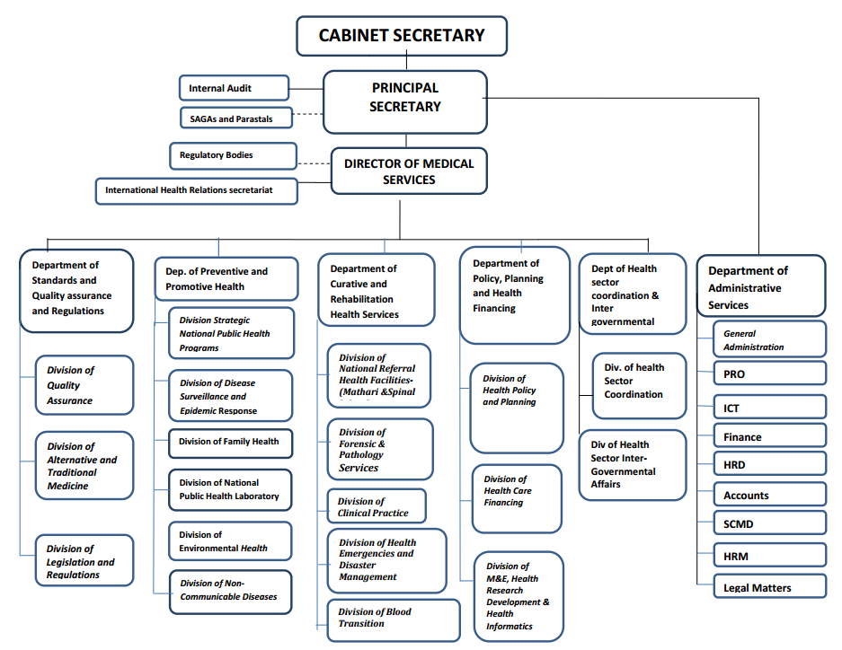
ORGANIZATION STRUCTURE.
MOH STRUCTURE ORGANOGRAM

Slide 19
Who is the CS for health in Kenya.
Who is the PS for MOH in Kenya
Who is the CEC for health in your home County?
Functions of department of curative and rehabilitation health services
Increased access to quality clinical care in slum areas-
Increased access to emergency medical care and disaster management-
Increased access to quality national forensic and pathology services

Slide 20
Functions Of Department Of Preventive And Promotive Health
Prevalence and incidence of preventable conditions-Level of public awareness and of practice of positive health behaviors
Core mandate of MOH
Health Policy and Standards Management
Preventive, promotive and curative health services | Cancer Policy
Health education management | Public Health and Sanitation
National health referral services | Policy Management
Health inspection | Medical Services Policy
Coordination of campaign against HIV/AIDs | Reproductive Health policy
Pharmacy and Medicines control | Nutrition Policy
National Medical Laboratories Services | Registration of Doctors and Para-medics
Training of Health Personnel | Quarantine administration

Slide 21
County government
The role of the county government is to provide strategic and operational leadership and stewardship for overall health management in the county, including provision of health services, resource mobilisation, creation of linkages with national level referral health services, monitoring and evaluation, coordination and collaboration with state and non-state stakeholders at the county level.
The Kenya Health Policy 2012-2030 proposes the formation of county health departments whose role is.
“Coordinating and managing the delivery of health care mandates and services at the county level”. provide strategic and operational leadership and stewardship for overall health management. resource mobilisation, creation of linkages with national level referral health services, monitoring and evaluation, coordination and collaboration with state and non-state stakeholders at the county level.

Slide 22
Roles of Health facility management teams
Providing health services, developing and implementing facility health plans, coordinating and collaborating with stakeholders through County Health Stakeholder Forums, supervising, continuously monitoring and evaluating health service provision and implementing health policies.
Source: Kenya Health Policy 2012-2030.

Slide 23
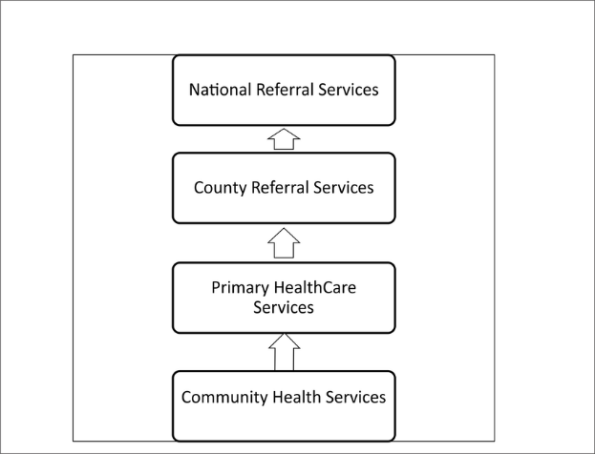
ORGANIZATION OF MOH IN DEVOLUTION

Slide 24
The MOH is organized into six levels of hierarchy
Level 1. Community services / facilities.
Level 2. Dispensary and clinics.
Level 3. Health centers. Maternity and nursing homes.
Level 4. Sub-county hospitals, medium sized private hospitals.
Level 5. County referral hospitals and large referral hospitals.
Level 6. Teaching and referral hospitals. KNH. MTRH, Mathari teaching and referral hospital, national spinal injury hospital.

Slide 25
MOH tiers.
Tier 1: Community.
Tier2: Primary Care level – levels 2 and 3
Tier 3: County level – level 4
Tier 4: National level – levels 5 and 6

Slide 26
Role of Ministry of Health (MoH) in service delivery.
Curative Services. Level 4, 5 and 6
Health Promotion & Prevention. Level 1, 2 and 3
Key system actors.
The public sector represented by MoH and other government institutions
The private health sector (being private for-profit and private not-for-profit) Alternative medicine practitioners
Individuals and households that ensure care and support for their families and
The communities they live in
Development Partners

Slide 27
Ministry of Health (MOH) levels and Functions / Responsibilities.
Level 1. Responsibilities - Community health facility.
Staff – Community Health workers – CHWs, community health volunteers CHVs, community health medical health workers CHMHW, community members.
Give services at homes and homesteads in health prevention measures on causes of illness and proper sanitation.
Promote access to services, provide health education, support care delivery, and promote advocacy.
Offer Primary health care. Ensure individuals, households, communities carry out appropriate healthy behaviors. Recognize signs and symptoms of conditions that need to be managed at other levels.
Facilitate community based referral.

Slide 28
Level 2. Responsibilities - Health Dispensaries.
Staff. Nurses
Offer Primary health care. Outpatient services. VCT services. Tuberculosis services. Laboratory Services. Well baby Clinics. Antenatal and Postnatal services. Pharmacy. Counselling services.
Diagnosis is made through signs and symptoms.
Preventive, promotive health care. Facilitate referral of clients from communities and level three facilities.
Give an example.

Slide 29
Level 3. Responsibilities - Health Centres
Staff. At least One doctor, clinical officers and nurses
Offer Primary health early care, outpatient services, MCH/FP, immunization services, Detection, diagnosing and management of diseases
Have a laboratory for routine lab investigations, pharmacy.
No theater. Has a ward. Offer Maternity in-patient services.
Diagnosis is made through investigations
Preventive, curative, promotive, inpatient services.
Give an example.

Slide 30
Level 4. Responsibilities – Sub-county hospitals
Staff. Doctors, clinical officers and nurses and other health care providers.
Services offered are outpatient, emergency maternity, basic laboratory, and minor surgical procedures. screening, curative services, secondary health care
Food quality, safety and fortification advocacy, school health programs or outreach and population management services.
Preventive, curative, promotive, management of lower facilities.

Slide 31
Level 5 responsibilities - County referral hospitals
Staff. Medical specialists, Doctors, Clinical officers and nurses and other health care providers .
Offers screening, curative services, secondary health care. Surgical services, including reproductive health.
Training services for various groups of health workers and internships, specialized care functions, attendance during childbirth, intensive care, and medical imaging services, coordinating the management and extending health support to the sub-counties.
Manage all, highly complex patients. and procedures. Act as referral service for all but the most complex service needs.
Preventive, curative, promotive, management of lower facilities.
Facilitate and manage referral from level 2 and 4. Together with other level 3 facilities form county level referral sytem.
County governments manages these hospitals

Slide 32
Level 6 responsibilities - National Referral Hospitals
Staff. Medical specialists
Offers. Secondary / tertiary health care
Offer. Highly specialized consultations in curative care, highly complex, high-risk patients. curative, promotive, rehabilitative, teaching and research services.
Kenyatta National Hospital and Moi Teaching and Referral hospital, Mathari teaching and referral hospital
National Spinal Injury Referral offers specialized services in orthopedic and spinal injuries.
The national government manages these three hospitals.

Slide 33
Health services
Mental health care.
Dental care.
Laboratory and diagnostic care.
Substance abuse treatment.
Preventative care.
Physical and occupational therapy.
Nutritional support.
Pharmaceutical care.

Slide 34
Cadres in health care services
Health Records and Information Officers (HRIOs),
Community Health volunteers (CHVs) and
Emergency Care Professionals (ECPs).
……………………………………………………………..

Slide 35
Levels Of Health Care
Categories of health care
Primary care. Healthcare provided in the community for people making an initial approach to a medical practitioner or clinic for advice or treatment.
Delivered in outpatient settings, as the low-level care and consultations provided to patients do not require hospitalization. Level 1 and 2
Secondary care. Is more specialized and focuses on helping patients who are struggling with more severe or complex health conditions requiring the support of a specialist.
Eg. care is often found in a hospital emergency department. Includes skilled attendance during childbirth, intensive care, and medical imaging services. "secondary care" is sometimes used synonymously with "hospital care".
Tertiary care. Highly specialized medical care usually over an extended period of time that involves advanced and complex procedures and treatments performed by medical specialists in state-of-the-art facilities. Level 5 and 6. KNH, MTRH
Quaternary care
An extension of tertiary care in highly specialized centers. National spinal injury hospital, mathari teaching and referral hospital.

Slide 36
Referral System:
A comprehensive health care system used to manage client health care needs by referring clients from an initiating facility to an organization, service, or community unit that can better provide the level of care needed.
Referral Management System.
Is a unique and powerful tool for health providers to keep track of their patient referrals throughout the care continuum. Its main goal is to improve and streamline communication among primary care physicians, specialists, and health providers involved in a patient's care.

Slide 37
Referral System In Primary Health Care
Healthcare providers at lower levels of the health system seek the assistance of providers who are better equipped or specially trained to guide them in managing or to take over responsibility for a particular episode of a clinical condition in a patient.
Actors In Healthcare Services In Kenya
The Kenyan healthcare system can be split into three subsystems, ...
Non-governmental actors such as
Non Governmental Organizations - NGOs
Faith Based Organizations – FBOs
Public health- Private practitioners, herbalists.

Slide 38
References and Recommended Further Reading.
Health Systems 20/20 (2012) The Health System Assessment Approach: A How-To Manual. Version 2.0. Available at <www.healthsystemassessment.org> [Accessed 24 February 2014].
Management Sciences for Health (2005) Managers Who Lead. A handbook for improving Health services (3rd ed). Cambridge: MSH
The end

